Slide 1
A System for Rapid Exploration of Shader Optimization Choices
Yong He (Carnegie Mellon University)
Tim Foley (NVIDIA)
Kayvon Fatahalian (Carnegie Mellon University)
Notes:
Today I want to talk about a new shader compiler that can help you with some interesting optimizations.

Slide 2
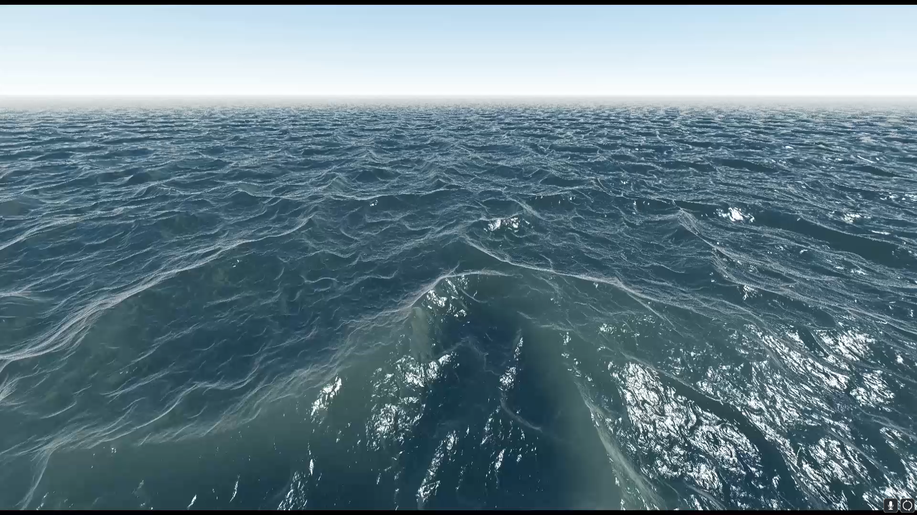
For every pixel on screen:
1: Ray Marching Procedural Water Surface
2: Evaluate surface appearance
Notes:
Let me start by giving you a few examples of optimizations that game developers might do today.
The water you are seeing here is rendered using a fragment shader that ray casts a procedural height field and shades the hit points.
||
It’s a complex two step operation.
The obvious way to make it faster is to simplify the math. For example I can change the fragment shader to use a simpler wave function to generate the height field.

Slide 3
Compute at half resolution
1: Ray Marching Procedural Water Surface
Compute at full resolution
2: Evaluate surface appearance
Notes:
And that can take my run time from 8ms down to 5ms, with a little lost in quality. However, I can do better than that. || Since the ray marching step is very expensive, I can do it at half resolution.

Slide 4
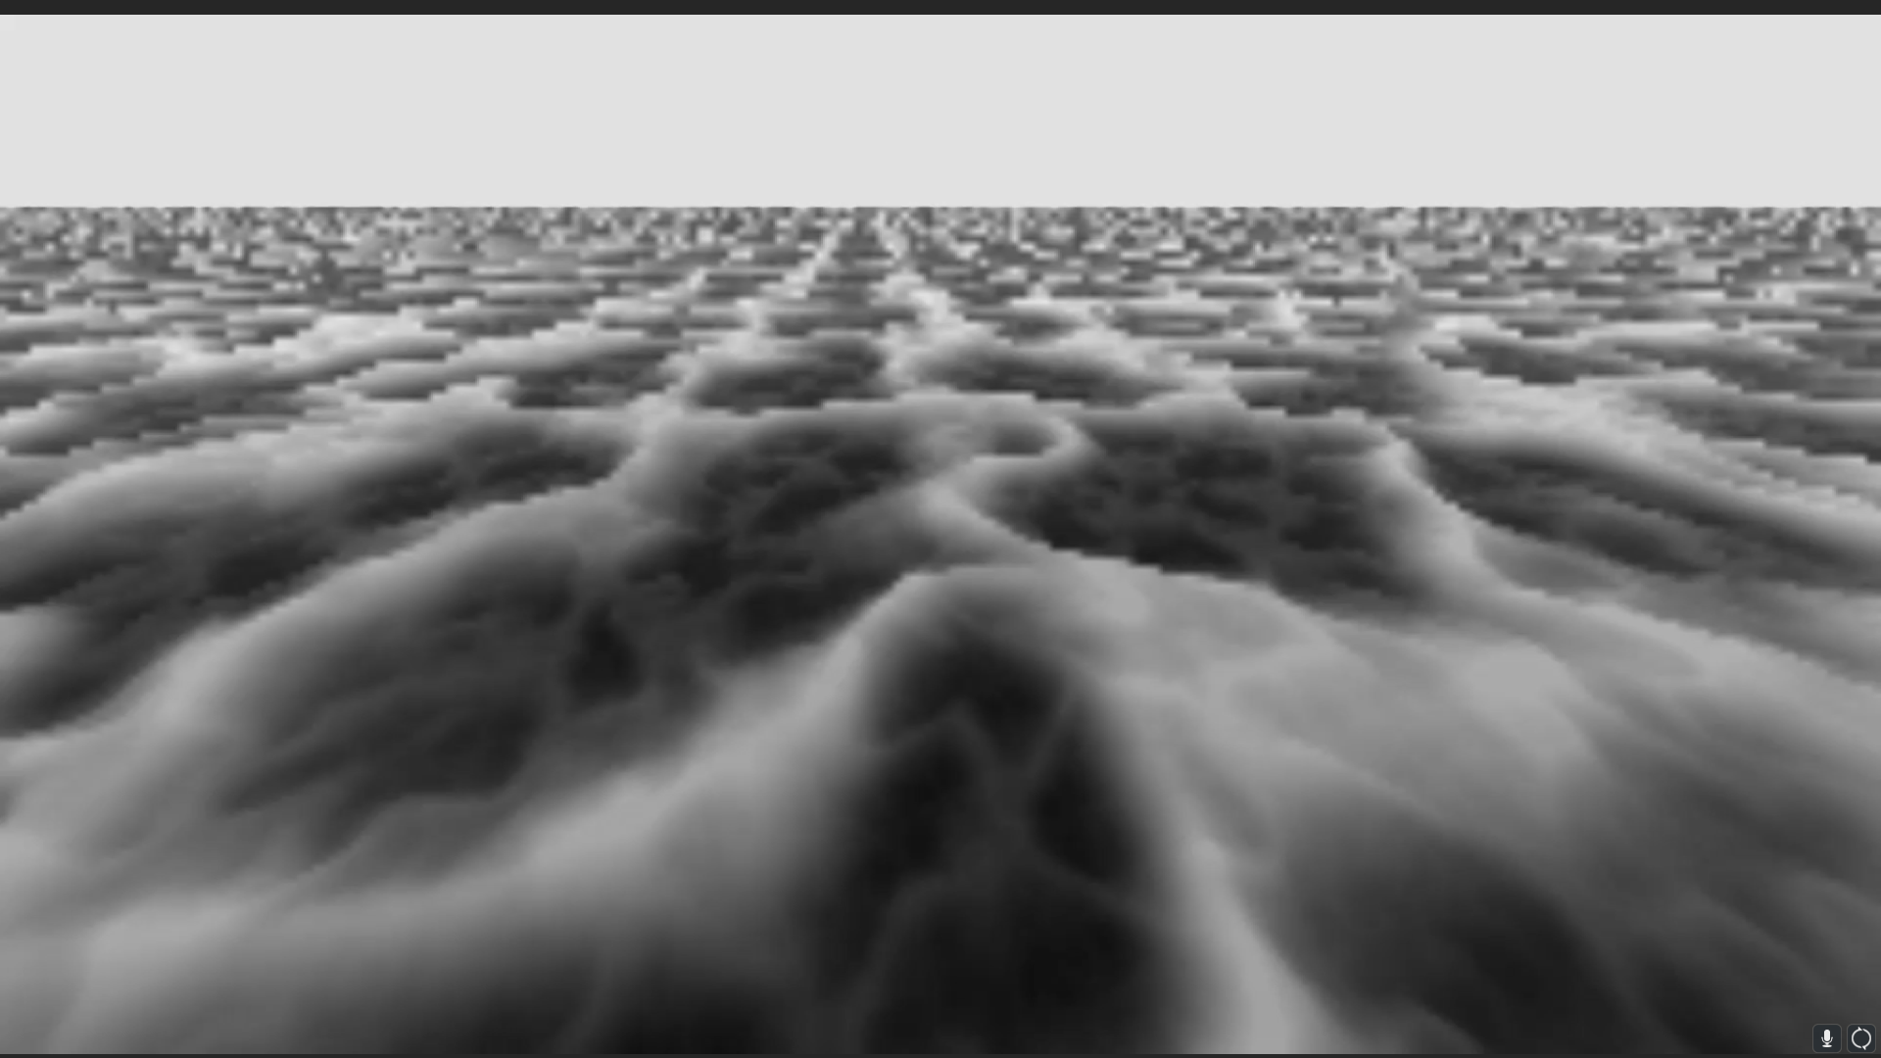
Notes:
Here are the low resolution ray-hits. But if I take these hit points, upsample and evaluate appearance at full resolution,

Slide 5
3.2 ms
Notes:
it still looks quite good, but runs much faster. Now I am at 3ms per frame.

Slide 6
Conceptually simple optimization requires significant implementation change
Render Pass 1 – Half Resolution
Render Pass 2 – Full Resolution
ray marching procedural water surface
computes normals and shading
Vertex Shader
Ray Marching Fragment Shader
Vertex Shader
Surface AppearanceFragment Shader
Texture Buffer
(Intersection Points)
(new shaders)
(new shaders)
Notes:
Even though it is easy to describe, actually implementing the optimization requires a lot of work. ||
(fast) To do that, I need to write two render passes, || one that runs in half screen resolution to computes the hits, and || the second pass runs in full resolution to compute shading.
||
Each pass has its own vertex and fragment shaders so I have to rewrite my shaders.
||
And lastly I have to allocate an intermediate texture to store the hit points.
As you can see, that’s a lot of work to implement this conceptually simple optimization: I changed CPU code, GPU code and allocated new buffers.

Slide 7
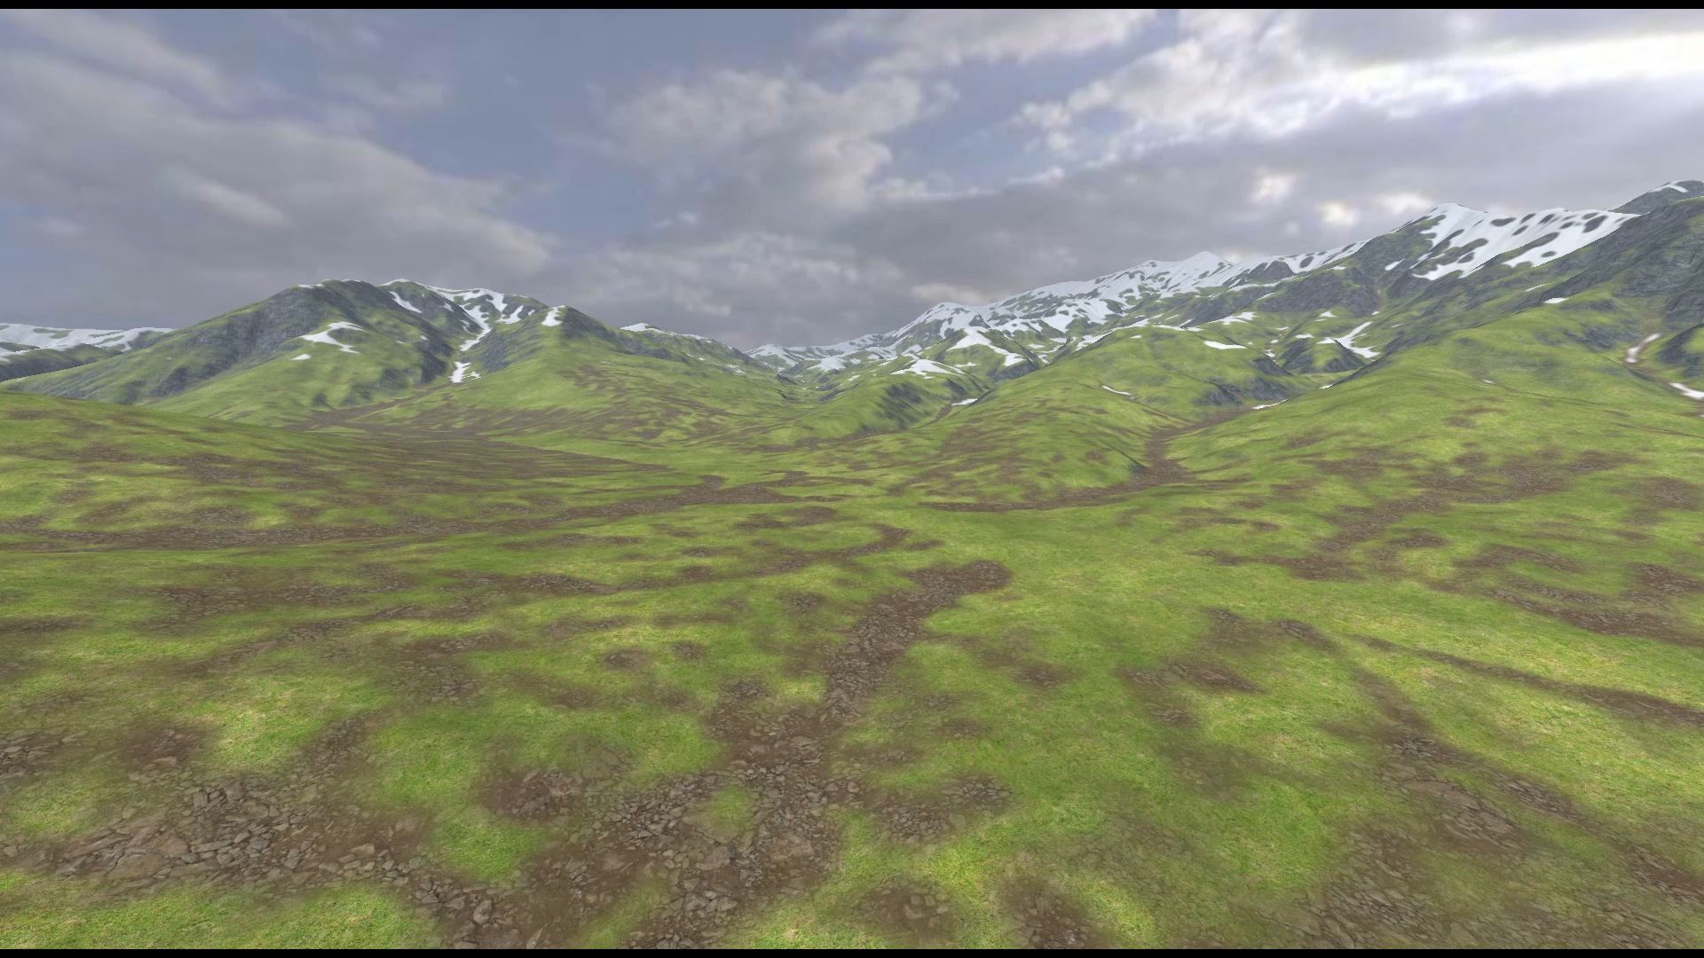


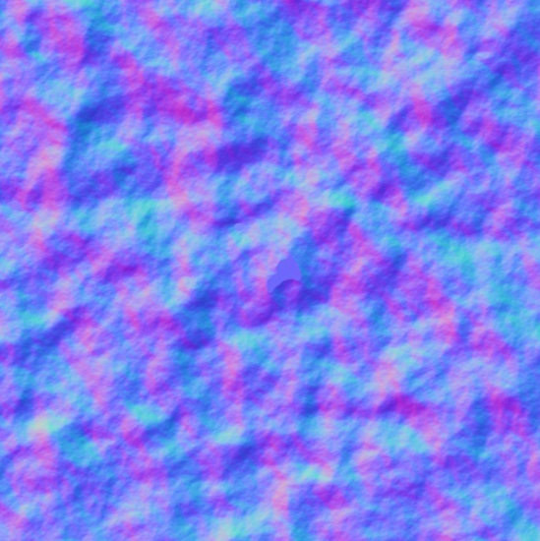



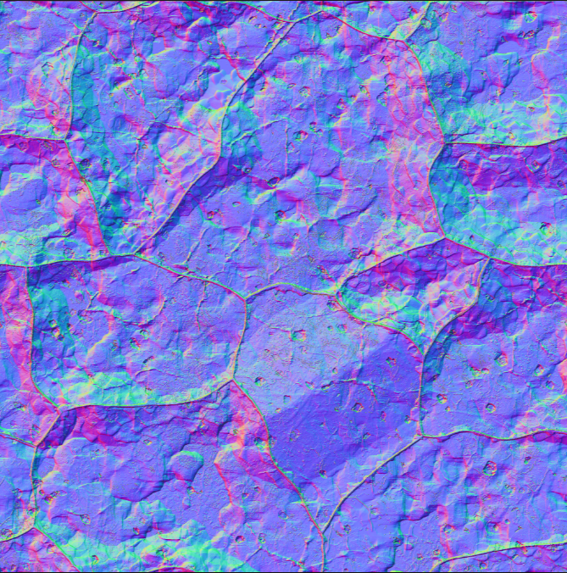



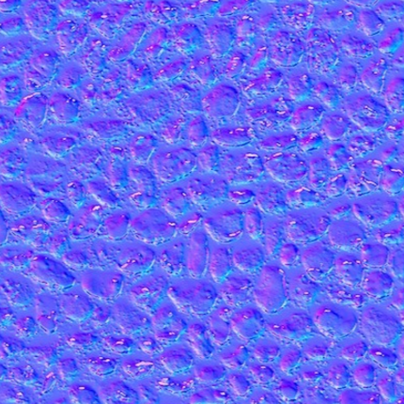
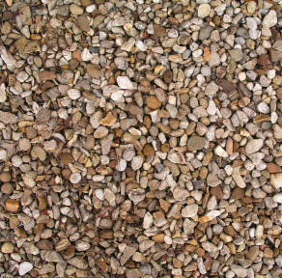
Rendering Algorithm:
Blend Several Layers of Material
Snow
Grass1
Grass2
Soil
Rock
Pebbles
Notes:
And this is also true for other types of optimizations.
For example here’s terrain shader taken from unreal marketplace, it blends many different material layers. ||
In this case we have six different layers of albedo and normal maps. This can be too expensive.
A common optimization, is to precompute the combined textures and reuse them every frame.

Slide 8
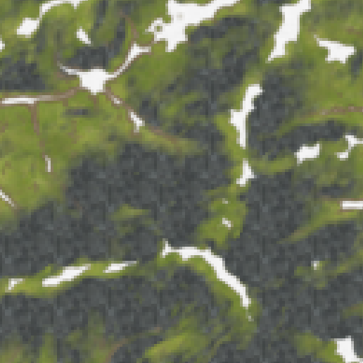

Optimization: Precompute composite texture
Compute Shader
Fragment Shader
(Single Texture Fetch)
Executed Once
Executed Every Frame
Notes:
But to actually implement this idea, I need a compute shader to composite the textures once, and a cheap fragment shader || that reuses the results each frame.
Again this requires writing new render passes and changing the shaders.

Slide 9
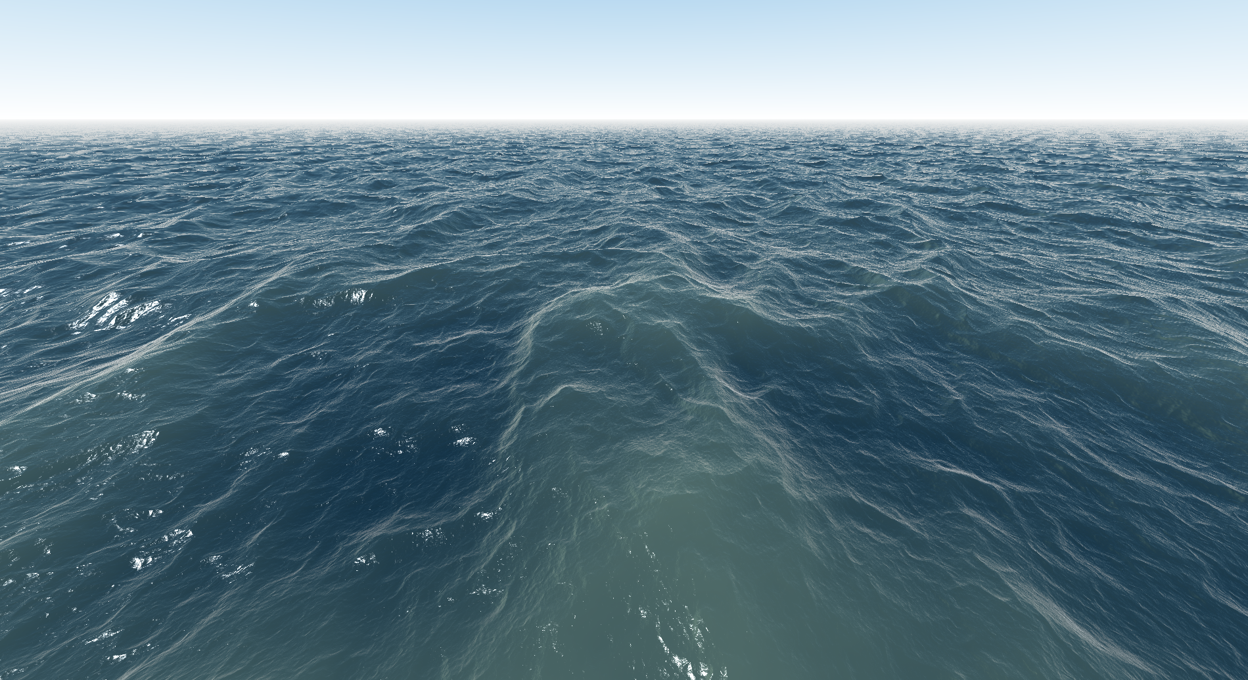
Goal: A system that generates different implementations from a high level representation
“compute everything
in fragment shader”
Implementation 1
Ray-Casting
Water Rendering Algorithm
Compile
Vertex Shader
Fragment Shader
Engine Code
“ray marching
at half res”
Implementation 2
Compile
Vertex Shader 1
Fragment Shader 1
Vertex Shader 2
Fragment Shader 2
Engine Code
Notes:
It would be nice if I could describe the optimizations as easy as I just did, and have a tool to generate the low level implementations. ||
For example, I would like to just write the water rendering shader once, then || tell the compiler that i want to compute everything in fragment shader, || and I will get the resulting shader and pipeline code, or || I can also say “do ray marching at half resolution”, || and I will get the multi-resolution implementation described earlier.

Slide 10
Contribution:
Spire: a new representation (compiler IR) for shaders
Enables rapid exploration of different performance-quality trade-offs spanning multiple render passes (offline processing, object space and screen space shading)
Supports building tools that automatically exploring optimization choices (auto-tuning)
Not specific to any particular rendering engine
Notes:
As a step towards this goal, we developed a shading language and compiler called Spire that makes it easy to describe and explore a set of nontrivial shader optimizations.
The key idea is a new shader representation that enables rapid exploration of different optimization trade-offs, even when those trade-offs span multiple pipeline stages or render passes. ||
With our proposed representations, you can easily build powerful optimization tools, such as automatically finding the best implementation for a given performance budget ||
And unlike the shading systems in engines like unreal and unity, Spire’s representations are not specific to any one graphics engine, you can think about Spire as a shader compilation service that ideally could be used by any engine.

Slide 11
Spire Concepts
Notes:
Now let me show you what spire is in detail.

Slide 12
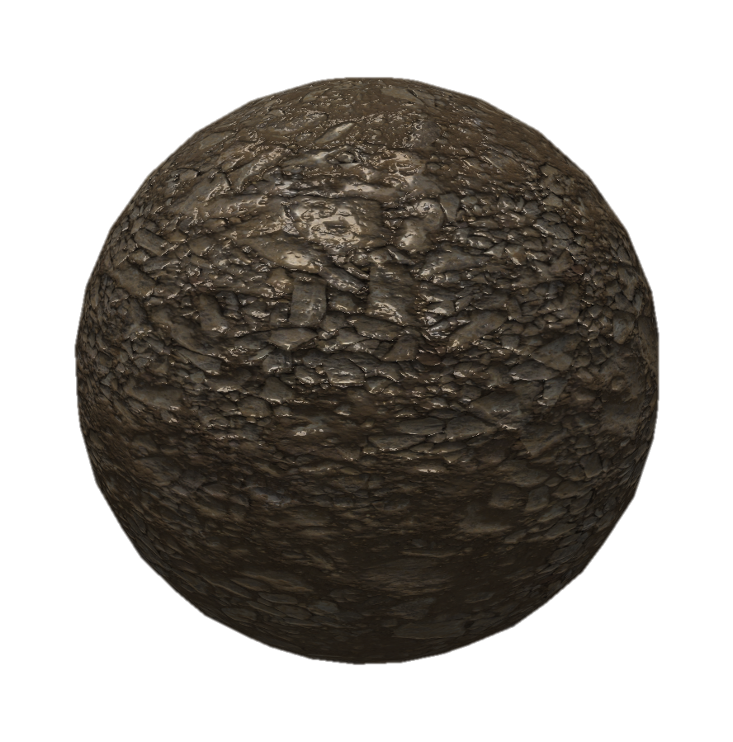
A Spire shader
shader DemoShader
{
vec3 vert_pos;
...
mat4 viewProjectionMatrix;
vec4 position = modelMatrix * vec4(vert_pos, 1.0);
vec4 projCoord = viewProjectionMatrix * position;
vec3 albedo = texture(ground_pebble_map, uv).xyz;
vec3 normalTex = (texture(ground_pebble_Nmap, uv).xyz - 0.5) * 2.0;
vec3 normal = normalize(normalTex.x * vTangent + ...);
float highlight = ComputeHighlightPhong(lightDir, normal, view, roughness, specular, metallic);
...
out vec4 outputColor = vec4(lightColor * (lambert + highlight), 1.0);
}
Vertex Transformation
Normal Computation
Lighting
Notes:
Here is a spire shader that is simple enough to fit in this slide.
The actual code is not important, but you just need to know that the shader || evaluates projected vertex positions, || fetches albedo and normal textures, || and computes the lighting.

Slide 13
A Shader is a data flow graph of components
shader DemoShader
{
vec3 vert_pos;
...
mat4 viewProjectionMatrix;
vec4 position = modelMatrix * vec4(vert_pos, 1.0);
vec4 projCoord = viewProjectionMatrix * position;
vec3 albedo = texture(ground_pebble_map, uv).xyz;
vec3 normalTex = (texture(ground_pebble_Nmap, uv).xyz - 0.5) * 2.0;
vec3 normal = normalize(normalTex.x * vTangent + ...);
float highlight = ComputeHighlightPhong(lightDir, normal, view, roughness, specular, metallic);
...
out vec4 outputColor = vec4(lightColor * (lambert + highlight), 1.0);
}
Shader Components
Notes:
The important thing to focus here are these highlighted terms that we call components.
And I want you to think about a shader as a directed graph of components.

Slide 14
A Shader is a data flow graph of components
shader DemoShader
{
vec3 vert_pos;
...
mat4 viewProjectionMatrix;
vec4 position = modelMatrix * vec4(vert_pos, 1.0);
vec4 projCoord = viewProjectionMatrix * position;
vec3 albedo = texture(ground_pebble_map, uv).xyz;
vec3 normalTex = (texture(ground_pebble_Nmap, uv).xyz - 0.5) * 2.0;
vec3 normal = normalize(normalTex.x * vTangent + ...);
float highlight = ComputeHighlightPhong(lightDir, normal, view, roughness, specular, metallic);
...
out vec4 outputColor = vec4(lightColor * (lambert + highlight), 1.0);
}
vert_pos
viewProjectionMatrix
position
normalTex
projCoord
normal
albedo
highlight
outputColor
Notes:
so a shader is a dag where nodes are components, and edges are data dependencies.
this is similar to the shader representations in many existing game engines.
[pause]

Slide 15
Components need to be evaluated in some shading stages
vert_pos
viewProjectionMatrix
position
normalTex
projCoord
normal
albedo
highlight
outputColor
Notes:
Note that a shader dag defines what components to compute, (slow) but it does not define in what pipeline stages the components should be evaluated.
And the challenge here, is that different graphics applications might offer different numbers and types of shading stages.

Slide 16
Compiler needs to know what stages are available
Single-Pass Pipeline
vert_pos
viewProjectionMatrix
vertex shading
fragment shading
normalTex
position
Multi-resolution pipeline
normal
projCoord
albedo
vertex shading 0
fragment shading 0
vertex shading 1
fragment shading 1
highlight
Terrain rendering pipeline
compute shader
vertex shading 1
fragment shading 1
outputColor
Notes:
For example a single pass rendering pipeline only provides two places to execute shader code: either at vertex or fragment stage. || And that multi-resolution rendering pipeline in the water rendering example offers four shading stages, as there are one set of vertex and fragment shading stages for each pass. || and the terrain rendering pipeline involves a compute shader that does not even run per frame.
. . .
Since a shader is just a graph of components, in order for the compiler to make it executable in many different pipelines, we need a mechanism for engines to declare where shader code can run.

Slide 17
Pipeline Definition
Worlds: places where shader code can run
Worlds
vs
fs
Notes:
And this is done by creating what we call a spire pipeline definition. The definition is how the engine exposes its capabilities to spire,
||
In a pipeline definition, the places where shader code can run are called || worlds. For example a single pass vertex-fragment pipeline is modeled with two worlds: one for the vertex shader that I’ll call “vs” and one for the fragment shader that I’ll call “fs”.

Slide 18
Defining a pipeline
frameUniform
meshVertex
vs
fs
Input worlds
Notes:
And we also need someway to describe where the shader inputs are coming from. For that, a pipeline also defines || input worlds, which do not run code but instead to hold inputs provided by the engine. In this example there is one world that provides per-frame uniform values that I call it frameUniform, another that provides per vertex input that I call it meshVertex.
That is the definition for the simple rendering pipeline.

Slide 19
The multi-resolution rendering pipeline definition
frameUniform
meshVertex
lowResVS
lowResFS
vs
fs
Render Pass 1
Render Pass 2
Notes:
As another example, To define the multi-resolution rendering pipeline, we need worlds for the vertex and fragment shaders for the || low resolution pass and vertex and fragment shaders for the || full resolution pass.
We also need to define the inputs worlds, and data flow paths. For example uniform data is available to all the worlds.
[pause]

Slide 20
Need to map shader components to pipeline worlds
Shader graph: defines components
Pipeline definition: defines worlds
vert_pos
viewProjectionMatrix
frameUniform
position
normalTex
meshVertex
projCoord
normal
albedo
lowResVS
lowResFS
vs
fs
highlight
outputColor
Notes:
Now, || we have a shader, which defines components,
and || we have a pipeline definition which defines worlds where we can evaluate components.
|| And now we need to make decisions on how to map components to worlds where they will actually be evaluated.

Slide 21
Compiling shader graph against a pipeline
meshVertex
lowResVS
lowResFS
vs
fs
vert_pos
normalTex
frameUniform
position
normal
albedo
viewProjectionMatrix
highlight
outputColor
Notes:
Let’s say we are compiling the shader graph to the multi-resolution pipeline.
Here, are the worlds where I can place components.
=========
For some components, there’s no choice, || the input components are defined in input worlds, || and output value is a per fragment color. But for other components we have a choice, may be we want to compute everything per pixel for high quality, || so we are going place everything in fs world. But for components like the || highlight, we may also choose to evaluate it at lower resolution, so we can also place it in lowResFS world.
(
Since highlight depends on the values of normal and position, these components moved to left as well.

Slide 22
Compiling shader graph against a pipeline
meshVertex
lowResVS
lowResFS
vs
fs
vert_pos
frameUniform
albedo
viewProjectionMatrix
normalTex
position
normal
outputColor
highlight
Notes:
Since highlight depends on the values of normal and position, these components moved to left as well.
So we can see that the data dependencies in the shader graph constraints the available placement choices.

Slide 23
The Spire IR encodes the placement choices of components
vert_pos
viewProjectionMatrix
position
normalTex
projCoord
normal
albedo
highlight
frameUniform
meshVertex
outputColor
lowResVS
lowResFS
vs
fs
Notes:
(slow) The most important idea of spire is that we designed a shader representation that encodes all the possible placement choices. I am going to show you that placement choices as well as many other types of shader optimizations can actually be expressed by a single unified mechanism that I’ll call component overloading.
===
Now you are seeing a shader graph, and the multi-resolution pipeline definition.
For each shader component our Intermediate Representation tracks all of the possible worlds that the component is allowed to be placed in. || I will show the options using colored dots. Here the input and || outputs has only one dot, || and the rest components have more than one dots.

Slide 24
Placement choices are overloaded component definitions
vert_pos
viewProjectionMatrix
position
normalTex
normal@lowResVS
normal@lowResFS
normal@vs
normal@fs
projCoord
normal
albedo
highlight
frameUniform
meshVertex
outputColor
lowResVS
lowResFS
vs
fs
Notes:
More precisely, the placement choices of a component are represented as different definitions of the same component, and we say that the component is overloaded with these definitions, which is similar to the concept of function overloading where you have many different definitions of a same function. ||
Here the normal component has four overloaded definitions, one for each world in which it can be placed.
So when you compile a spire shader, the compiler runs a data flow analysis on the shader graph to figure out the placement choices, and for each component it generates the overloaded definitions for each allowed world.

Slide 25
Making placement choices is picking overloaded definition
vert_pos
viewProjectionMatrix
position
normalTex
normal@lowResVS
normal@lowResFS
normal@vs
normal@fs
projCoord
normal
albedo
highlight
frameUniform
meshVertex
outputColor
lowResVS
lowResFS
vs
fs
Notes:
So after that, making placement choices is just picking overloaded component definitions that would be used when running the shader.

Slide 26
Overloaded component definitions can be different
vert_pos
viewProjectionMatrix
position
normalTex
normal@lowResVS (impl #1)
normal@lowResFS (impl #1)
normal@vs (impl #1)
normal@fs (impl #1)
projCoord
normal
albedo
highlight
// implementation #1
vec3 normal = normalize(normalTex.x * vTangent + ...);
outputColor
Notes:
The nice thing about component overloading is that it can be used to do a lot more than representing placement choices. In this example, surface normal is computed using the same expression regardless of where it is placed at, but sometimes how you compute a component may differ depending on where it’s evaluated. For example, if normal is placed in the vertex shader we may just want to use the vertex normal instead.

Slide 27
Overloaded component definitions can be different
vert_pos
viewProjectionMatrix
position
normalTex
normal@lowResVS (impl #1)
normal@lowResFS (impl #1)
normal@vs (impl #2)
normal@fs (impl #1)
projCoord
normal
albedo
highlight
// implementation #1
vec3 normal = normalize(normalTex.x * vTangent + ...);
// implementation #2
@vs vec3 normal = vertNormal;
outputColor
Notes:
I can do that by explicitly writing an overloaded definition for normal at vs world, so that if it is evaluated at vs world, the overloaded definition will be used, which evaluates to the input normal from mesh vertex.

Slide 28
Algorithmic choices via component overloading
vert_pos
viewProjectionMatrix
position
normalTex
projCoord
normal
albedo
highlight@lowResVS (ggx)
highlight@lowResFS (ggx)
highlight@vs (ggx)
highlight@fs (ggx)
highlight@lowResVS (phong)
highlight@lowResFS (phong)
highlight@vs (phong)
highlight@fs (phong)
highlight
// implementation #1
vec3 highlight : ggx = lighting_ggx(...);
// implementation #2
vec3 highlight : phong = lighting_phong(...);
outputColor
Notes:
We can also use component overloading to represent choice of algorithms.
Here we have two variants of the highlight component that provide a choice between different BRDFs, this results additional overloaded definitions.

Slide 29
Shader Optimization = Picking overloaded component definitions
Notes:
(OK, if there’s one thing you can take away from this talk, is that)
Given spire’s IR, making sophisticated optimization choices amounts to choosing overloaded component definitions.
Choosing definitions is the way you can explore an interesting space of performance-quality tradeoffs, || such as spatial-temporal frequency, algorithm choice, choice of shading space, and other optimzations..

Slide 30
Shader Optimization = Picking overloaded component definitions
Spatial frequency of computation
Temporal frequency of computation
Processing multi-rate input
Algorithmic choices
Shading space choices
Notes:
(OK, if there’s one thing you can take away from this talk, is that)
Given spire’s IR, making sophisticated optimization choices amounts to choosing overloaded component definitions.
Choosing definitions is the way you can explore an interesting space of performance-quality tradeoffs, || such as spatial-temporal frequency, algorithm choice, choice of shading space, and other optimzations..

Slide 31
Relationship to prior work
Rate based data flow graph shader representation
Spark Shading Language [Foley 2011]
RTSL [Proudfoot 2001]
Decoupling optimization choices from algorithm description
Halide [Ragan-Kelley 2012]
Sequoia [Fatahalian 2006], Legion [Bauer 2014]
Exposing algorithm choice in the program
PetaBricks [Ansel 2009]
Spiral [Püschel 2005]
Notes:
Before I talk about the implementation of Spire, I do want to point out some of the similarities with prior work.
||
Spire is built upon many similar abstractions in the Spark shading language. And the rate based notion of shaders is also inspired by RTSL.
||
Component overloading is the mechanism to represent multiple optimization decisions in a shader, in a sense it provides some means of decoupling optimization choices from the program, such as what halide did for image processing, and sequoia and legion did for super computing systems.
||
Component Overloading provides additional algorithmic choices as well, which is explored by the systems like petabricks and spiral.

Slide 32
Spire Implementation
Notes:
Now that you know all the main ideas, let’s talk about implementation.

Slide 33
Spire System
Pipeline
Definition
Compiler Frontend
Choice Maker
Compiler Backend
Spire
Shader
shader IR
with space of
optimization choices
shader IR
with choices made
kernel code for each pipeline stage
(GLSL)
Notes:
We have implemented the spire compiler tool chain. The compiler frontend takes in a pipeline definition and a shader and produces an intermediate representation that encodes all the optimization choices. The choices can be made by a human programmer or perhaps by some automated tools. Finally, the backend generates shader kernels that can be run by the engine.
[pause]

Slide 34
System Demo
Notes:
Now let me show the full system in action.

Slide 35
Summary
A new representation for shaders that enables shaders to encode optimizations choices
Component Overloading – unified mechanism to express different types of optimizations
Compiler framework and tools available on GitHub
https://github.com/csyonghe/Spire
Notes:
So in summary, we presented a new shading language and compiler framework that enables rapid exploration of shader optimization choices. The key idea is an intermediate shader representation that is decoupled from rendering pipelines, and use component overloading as an unified way to express different types of optimizations.
This entire system is now available open source on github.

Slide 36
Spire is a first step towards the bigger goal of engine optimization
Shading Algorithm
High Level Renderer Description
AI Behavior
Animation
High Performance Graphics Application
Notes:
The current design of spire is really about generating shaders that implements different choices, but there are many other interesting decisions and perhaps more difficult choices.
We are interested to get into a point where a large piece of engine code is automatically generated, for example it is both challenging and promising if we can || generate efficient rendering engine code, or helps game developers to write high performance, easy-to-maintain AI behavior and animation logic.

Slide 37
Thank you!
https://github.com/csyonghe/Spire
Notes:
Thank you for coming to our talk, and please check out our github repository for demos, tutorials and the compiler source code.

